Slide 1
WORK UPDATES PRESENTATION
FROM
Rishabh Kumar Srivastva
SAP ID- 52108159

Slide 2
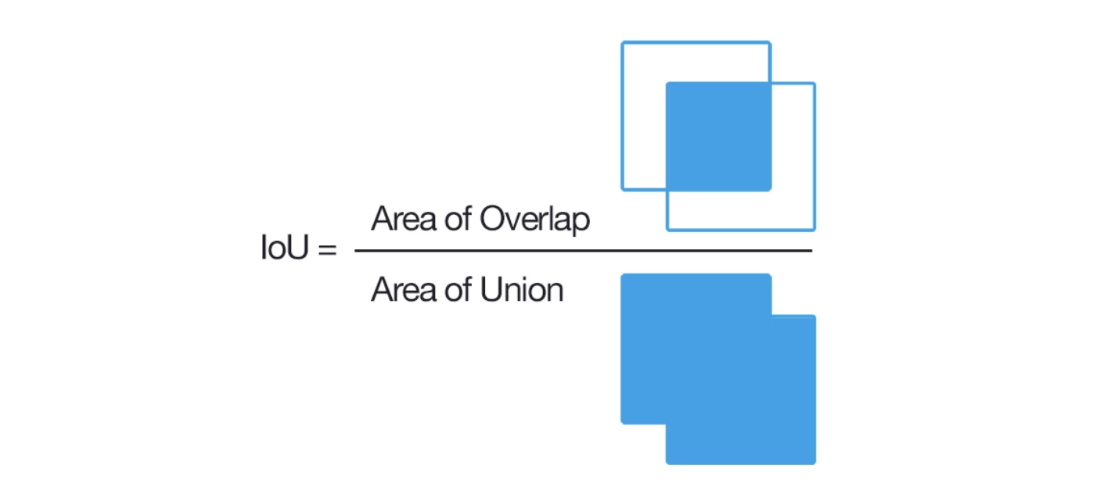
Metrics used
IoU means Intersection over Union - a metric used to evaluate Deep Learning algorithms by estimating how well a predicted mask or bounding box matches the ground truth data.

Slide 3
Comparison of Results for Eval on Pretrained Seaformer Pretrained Models
BACKBONE | DECODER | mIoU- Claimed in Paper | mIoU – Obtained using test.py | Latency – Claimed in Paper | Latency – Obtained using test.py
Seaformer-T | Light Head | 35 | 34.98 | 40ms | 39ms
Seaformer-S | Light Head | 38.1 | 38.91 | 67ms | 49.37ms
Seaformer-B | Light Head | 40.2 | 41.2 | 106ms | 60ms
Seaformer-L | Light Head | 42.7 | 43.02 | 367ms | 64ms

Slide 4
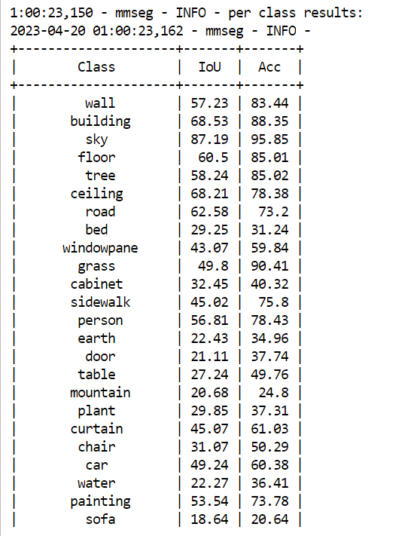
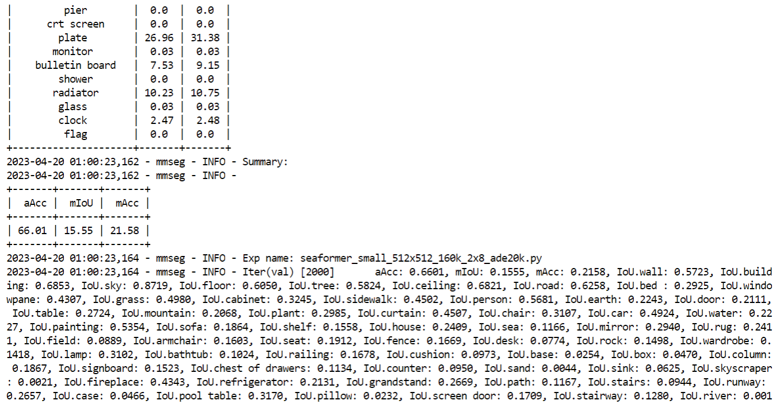
Seaformer – small

Slide 5
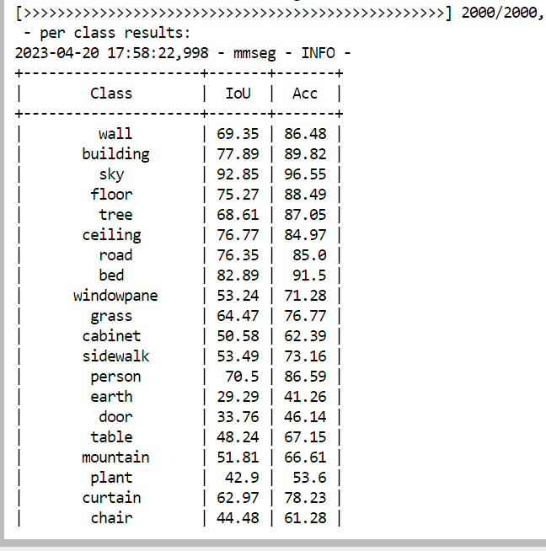
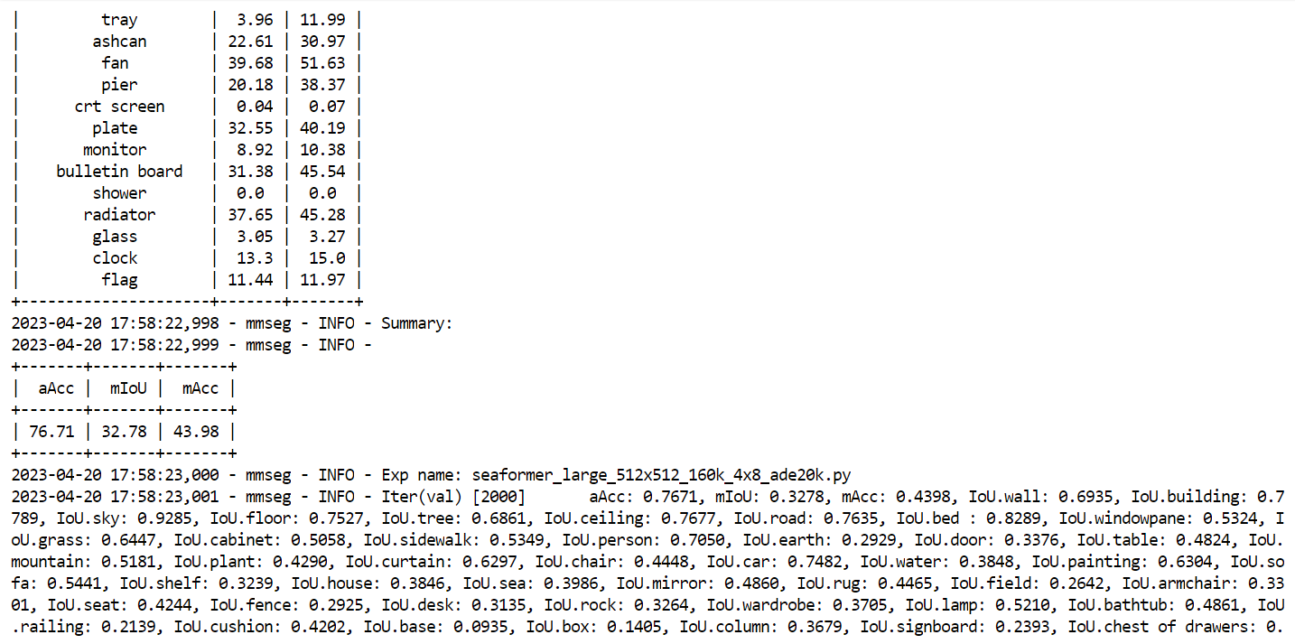
Seaformer – large

Slide 6
Results for Train&Eval using Seaformer with Transfer Learning
BACKBONE | DECODER | TRAIN DATASET- IMAGENET-1K | mIoU – Obtained using train.py | mIoU- Claimed in Paper
Seaformer-S | Light Head | Checkpoint file- SeaFormer_S_cls.pth | 15.55 | 38.1
Seaformer-L | Light Head | Checkpoint file- SeaFormer_L_cls.pth | 32.78 | 42.7
The model was not converging to its claimed optimum value. Batch size = 4 , no of GPUs = 1, lr = 0.0005

Slide 7
Results for Train&Eval using Seaformer with Transfer Learning : MODEL CONVERGENCE
To remedy the issue of Model Not converging, we tried various methods:
  Increasing the batch size to 32 , no of GPUs = 1 , lr = 0.0005 ---> ERROR: Insufficient Shared Memory/ Dataloader’s workers are out of shared memory.
  Kept batch size to 32 (samples per GPU = 16), no of GPUs = 2 (0,1) , lr = 0.00025 ---> ERROR: Insufficient Shared Memory/ Dataloader’s workers are out of shared memory.
  Changed batch size to 16 , no of GPU = 1, lr = 0.00025 , ----> Model improved its performance but, could NOT achieve Convergence with mIoU achieved = 40.25 , claimed mIoU = 42.7
  NOTE: Research Paper claimed Model Convergence with Batch size = 32 , with Distributed Training on 8 GPUs and lr = 0.0005

Slide 8
Future Scope
Achieve Model Convergence on Seaformer_ S and Seaformer_L using Distributed Learning on two GPUs , Batch size 16 (samples per GPU = 8), lr = 0.00025 ----> FINAL RESULT mIoU = 43.27
UNet paper/article study
InvUNet paper study (shared by Omkar)

Slide 9
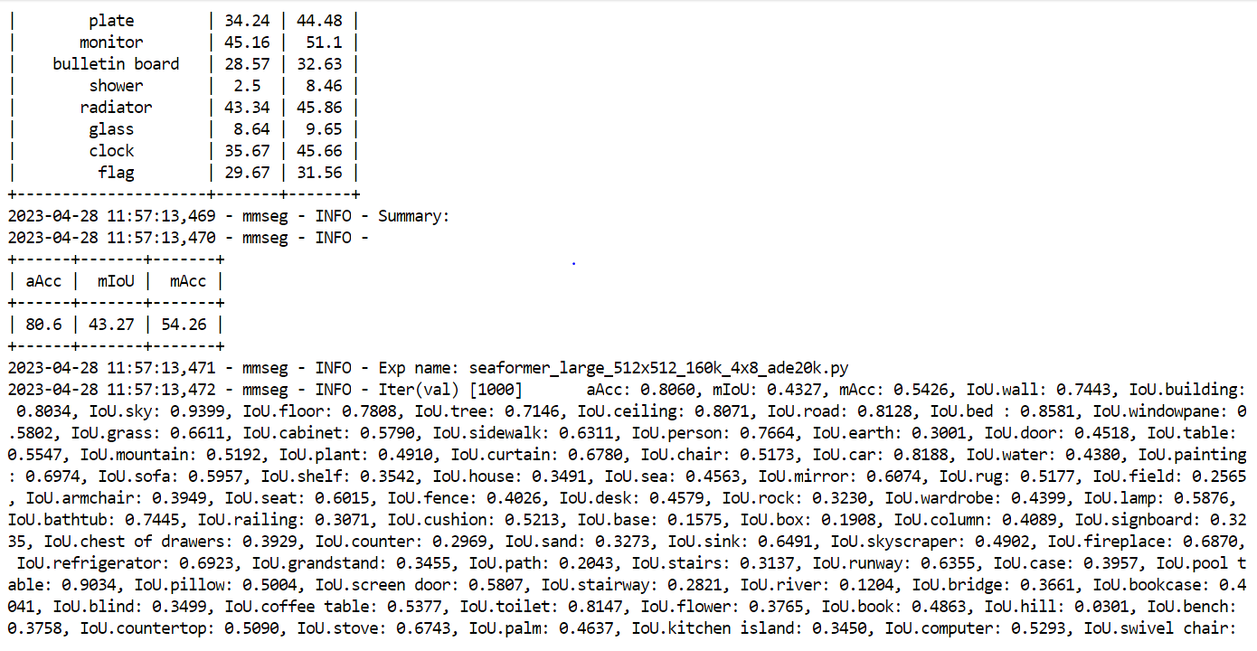

Slide 10
ERRORS ENCOUNTERRED
1. Insufficient shared memory (shm)
The error message shows you have insufficient shared memory (shm). It is not GPU memory. In computer hardware, shared memory refers to a (typically large) block of random access memory (RAM) that can be accessed by several different central processing units (CPUs) in a multiprocessor computer system.
If you type “df –h”, you will find something like below,
    Filesystem Size Used Avail Use% Mounted on
    udev 241G 0 241G 0% /dev
    tmpfs 49G 73M 48G 1% /run
    /dev/xvda1 1.9T 875G 1.1T 46% /
    tmpfs 241G 0 241G 0% /dev/shm
    tmpfs 5.0M 0 5.0M 0% /run/lock
    tmpfs 241G 0 241G 0% /sys/fs/cgroup
    /dev/loop1 18M 18M 0 100% /snap/amazon-ssm-agent/1480
    /dev/loop3 18M 18M 0 100% /snap/amazon-ssm-agent/1455
The /dev/shm shows how much shared memory you have. In this case, I think your shared memory is not big enough to train the model. You need to either decrease batch size or crop size, or find a way to increase your shared memory.

Slide 11
New commands learned
Nohup : (No hang Up) : nohup is a command in Linux systems that runs the process even after logging out from the shell/terminal.
Usually, every process in Linux systems is sent a SIGHUP (Signal Hang UP) which is responsible for terminating the process after closing/exiting the terminal. Nohup command prevents the process from receiving this signal upon closing or exiting the terminal/shell. Once a job is started nohup.out file is used as the default file for stdout and stderr. If the output of the nohup command is redirected to some other file, nohup.out file is not generated.
Example 1: Below the output log file is redirected from nohup.out(this file won’t not be generated) to train_log.txt(this txt file would be generated and
CUDA_VISIBLE_DEVICES=1 nohup python /workspace/SeaFormer/seaformer-seg/tools/train.py /workspace/SeaFormer/seaformer-seg/local_configs/seaformer/seaformer_large_512x512_160k_4x8_ade20k.py > train_log.txt
Example 2 :
To redirect the output to the output.txt file:
$ nohup bash geekfile.sh > output.txt

Slide 12
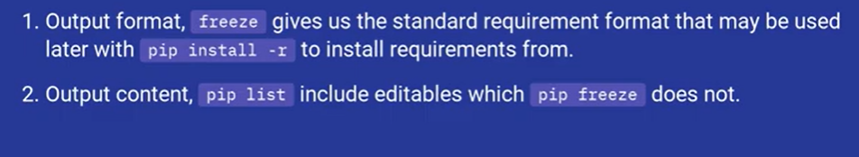
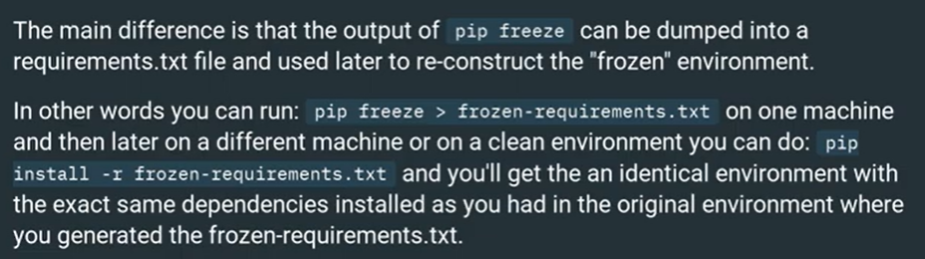
2. Pip freeze v/s Pip list

Slide 13
3. Distributed Training
python -m torch.distributed.launch --nproc_per_node=2 /workspace/SeaFormer/seaformer-seg/tools/train.py /workspace/SeaFormer/seaformer-seg/local_configs/seaformer/seaformer_large_512x512_160k_4x8_ade20k.py --launcher pytorch

